Slide 1
Next JS Assignment # 4
Presented by Ali Raza GIAIC Thursday Class 9am to 12 pm morning

Slide 2

What is Next Js?
Next.js is a React framework that gives you building blocks to create web applications.
Next.js enables you to create high-quality web applications with the power of React components.
Next.js is an open-source web development framework created by the private company Vercel providing React-based web applications with server-side rendering and static website generation.

Slide 3
Why we use Next Js?
Next.js is built on React and provides features like automatic code splitting, typescript, server-side rendering, and more. These unique features and Next.js capabilities enable developers to code more swiftly and efficiently and build performance-driven apps.
Enhanced Application Performance with Server-side Rendering (SSR).
Optimized Image Loading.
Reduced Initial Load Time with Automatic Code Splitting.
Application Performance Improvements with Caching.
Built-in Static Site Generation
SEO Benefits
Enhanced Developer Experience

Slide 4

What is React?
React is a JavaScript library created by Facebook.
React is a User Interface (UI) library. React is a tool for building UI components.
React, as it is a very declarative, fast, and flexible JavaScript library. It allows you to create complex user interfaces using “components,” or small, self-contained pieces of code. It controls the view layer in web applications.

Slide 5
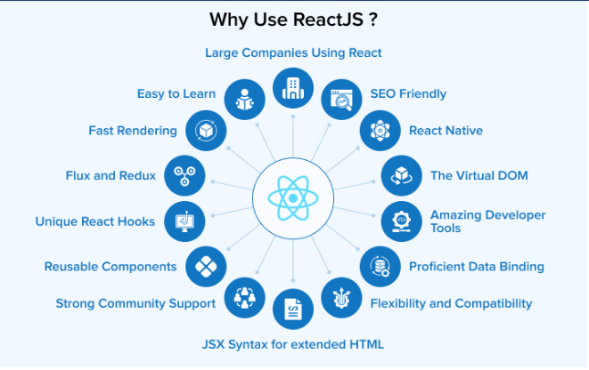
Why we use React?
The developers have complete control over React JS. It can also be used to create SPA, and web apps. You can include any number of external libraries and tools to create large and complex web applications.

Slide 6
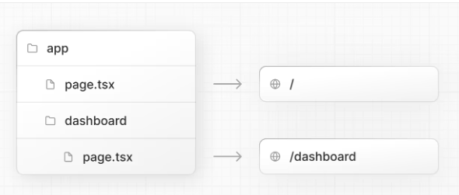
What is the page.tsx file
page.tsx is a special Next.js file that exports a React component, and it's required for the route to be accessible.
Defines a page and its contents that the user will see and interact.
Adding a page file to a directory defines a new route at that file path
Create a new route segment using a folder, and add a page file inside it
The file app/page.tsx is the home page associated with the route.

Slide 7
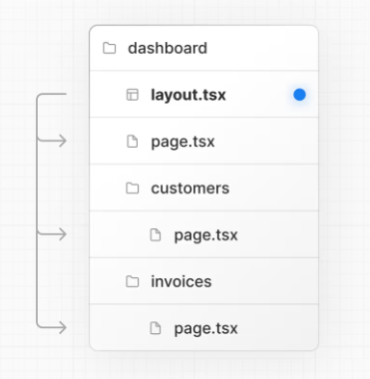
What is the layout.tsx
Layout.tsx is that app JS is used for global elements that must be present on all pages, while Layout. tsx is used to define specific layouts for pages or groups of pages. You can combine both options according to the needs of your application to achieve a coherent structure and design.

Slide 8
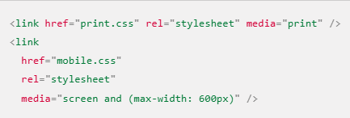

What is the Link Tag
The link tag is an HTML element that creates hyperlinks, or links, on web pages. Hyperlinks are clickable text or images that allow users to navigate between web pages or sections of a web page.

Slide 9
Why do we use Link Tag, and what is its purpose
The link tag to create hyperlinks that link web pages or resources together.
Links help users navigate between pages and sections of a website
Search engines use links to discover new pages on websites, and linked pages are considered more important or relevant
Links can be used to implement reference mechanisms like tables of contents, footnotes, bibliographies, indexes, and glossaries.
Links can express relationships between resources other than just "activate this link to visit that related resource.

Slide 10
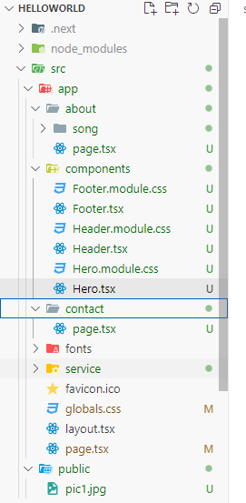
How can we create nested pages in Next.js?
In Next.js, routing is based on the file system. Each file in the pages directory corresponds to a route in the application.
Nested routes can be introduced in this file system by creating sub-directories inside the ‘pages’ directory. In the same way, multiple sub-directories can be created within a sub-directory.
Step 1: Create a new directory called ‘nested’ inside the ‘pages’ directory.
Step 2: Create a new page called ‘index.js’ inside the newly created ‘nested’ directory which will be the root page for the ‘nested’ directory.
Step 3: Create a new page called ‘nested_page.js’ inside the ‘nested’ directory.

Slide 11
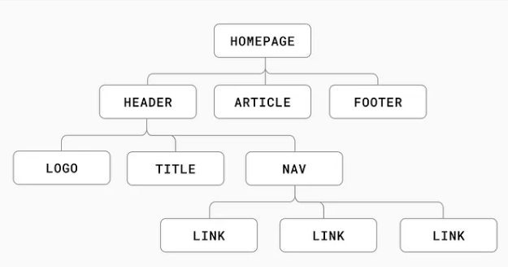
What are components, and why do we use them?
Next.js components are integral to building modular and efficient applications, offering tools like Image, Link, Script, and Font to handle media, navigation, scripts, and typography effectively.
Developers can use existing components to build applications faster, with fewer bugs and less testing
Developers can create separate components and integrate them into a project.
Components can improve the performance of an app.
Components can make it easier to handle errors
Components can be updated separately, so you can change one section of an app without updating everything

Slide 12
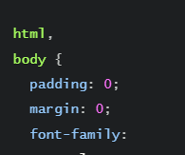
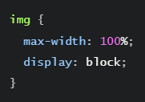

How can we apply CSS in Next.js?
In Next. js, you can add global CSS files by importing them from pages/_app. js . You cannot import global CSS anywhere else.
Next.js has built-in support for CSS Modules using the .module.css extension. CSS Modules locally scope CSS by automatically creating a unique class name. This allows you to use the same class name in different files without worrying about collisions.

Slide 13

What is Tailwind CSS
Tailwind CSS is a utility-first CSS framework that simplifies web development by providing a set of pre-designed utility classes. These utility classes enable you to build custom designs without writing any custom CSS, promoting consistency, scalability, and efficiency.

Slide 14
What are the differences between Tailwind CSS and standard CSS?
Tailwind CSS was developed in 2017.
Uses utility classes to inline styles within the HTML markup. The same button styling in Tailwind.
Uses prefixed utility classes to denote breakpoints.
Utility-First, Responsive Design, Customizable, Performance-Oriented.
Cascading Style Sheets (CSS) was design in 1996
CSS uses selectors target elements, and properties to define styles.
Uses media queries to define styles for different breakpoints.
Selectors, Properties and Values, Cascading, Inheritance, Box Model.

